Slide 1
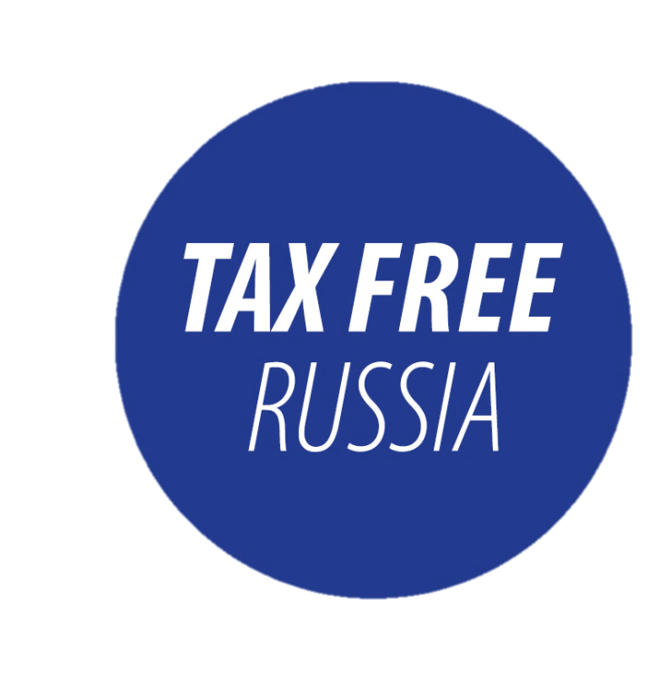



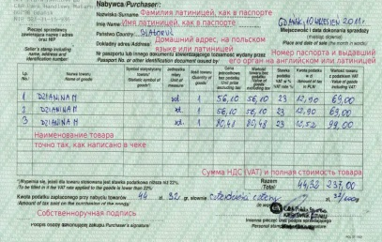
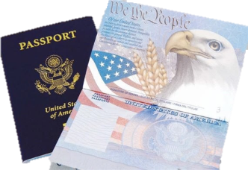




PROVISION OF tax free INFO
A customs officer will verify the following information:
goods information in your payment receipt
details of the retailer that issued your payment receipt
whether the information in your receipt corresponds to the goods you have bought
Present your payment receipt, your passport and the goods you have bought to the customs officer
Your foreign national passport
And stamp your payment receipt
If you fail to present any goods shown in your payment receipt, the customs officer will cross them out and validate it with his/her personal number stamp
Your payment receipt with the notes will be submitted to the tax free refund office
13.02.2018

Slide 2
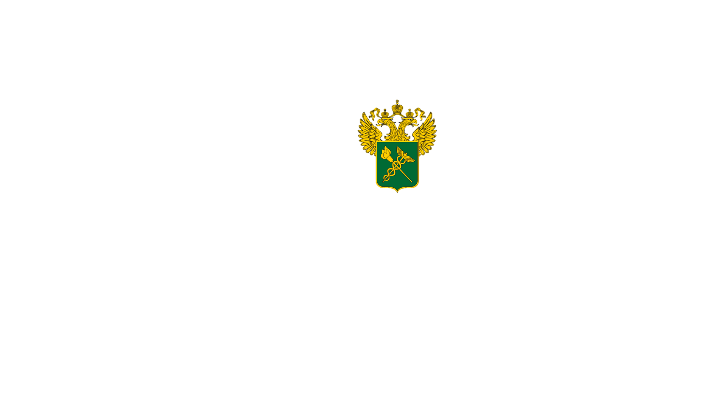
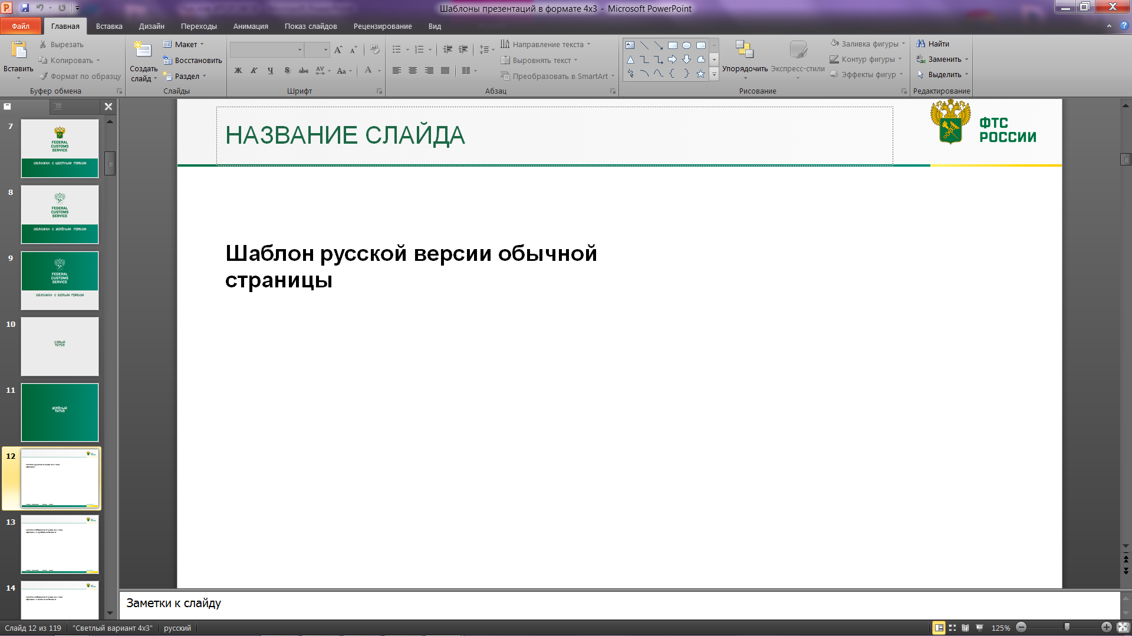
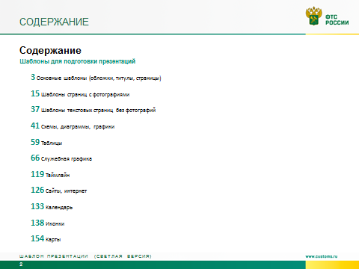
tax free SERVICE POINTS
Mamonovo (Grzechotki)
Russian-Lithuanian border
Moscow (VKO)
Moscow (DME)
Moscow (SVO)
Saint Petersburg (LED)
Sochi
Vladivostok (VVO)
Volgograd (VOG)
Yekaterinburg (SVX)
Kazan
Kaliningrad (KGD)
Nizhny Novgorod (GOJ)
Rostov-on-Don (ROV)
Samara (KUF)
Saransk
Vladivostok
Passenger Port (St. Petersburg)
Bolshoy Port (St. Petersburg)
International Road Border Checkpoints
International Air Border Checkpoints
International Sea Border Checkpoints
www.customs.ru

